Slide 1
8 Generating Random Variates
Ref: Law & Kelton, Chapter 8
JTB 2002

Slide 2
Overview
In our last set of lectures we learned about the process of generating a random number on the range (0-1].
In this week’s lectures we will learn about how we can turn a random number into a random variate.
The phrase “generating a random variate” refers to the process of obtaining an observation of a random variable from a desired distribution.
For example, let’s say we are simulating an arrival process with an exponential distribution (λ = 1). Using the techniques of chapter 7, we generate the random number 0.6. How do we turn these two pieces of information into a simulated inter-arrival time?
JTB 2002

Slide 3
Overview (Continued)
Generally, all random variates require the use of a U(0,1) distribution.
The exact technique used to generate an observation varies with the type of distribution used. However, in general we’re looking for techniques that are:
    Exact
    Efficient in terms of time, storage, and setup
    Low in complexity
    Robust.
JTB 2002

Slide 4
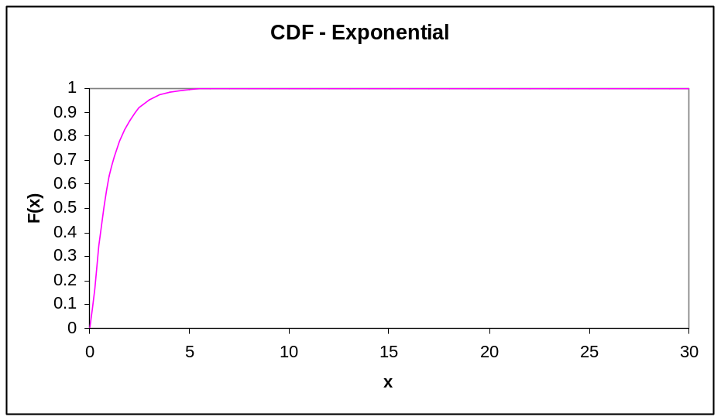
Inverse Transformation
On the right I have plotted the CDF for an exponential distribution with mean = 1.0.
Note that the CDF has a range [0,1].
If r = 0.6 is our “y” value on the CDF, the problem of generating a random variate is simply coming up with the corresponding “x” value.
By inspection, we can see that for r = 0.6, the value of x ~ .9
JTB 2002

Slide 5
Inverse Transformation - Exponential
For tractable distributions (like an exponential) we can easily determine the inverse transformation analytically.
Recall that F(x) = 1- e^{-x/β} is the CDF for an exponential distribution.
Let r (our random number) be F(x).
r = 1- e^{-x/β} Solving for x:
(1-r) = e^{-x/β}
ln(1-r) =-x/β
-βln(1-r) = x
if β = 1 and r = 0.6, then x = -1ln(1-.6) = .916
JTB 2002

Slide 6
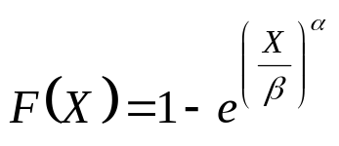
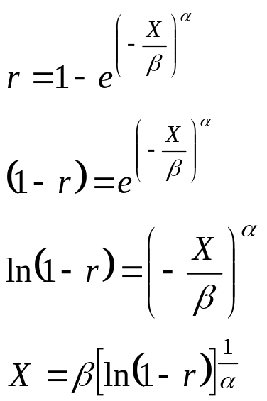
Inverse Transformation - Weibull
Recall the CDF of a Weibull is:
Letting r = F(X)
JTB 2002

Slide 7
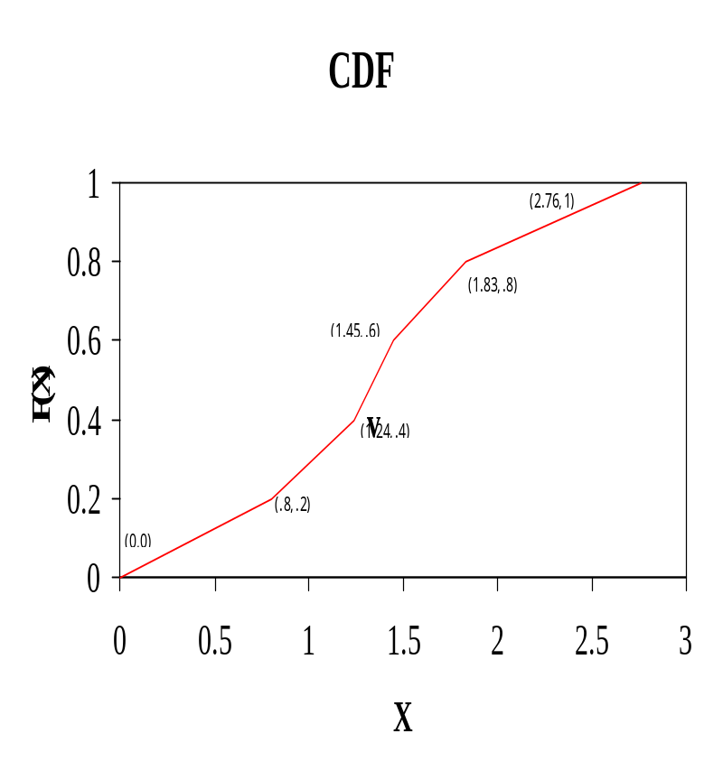
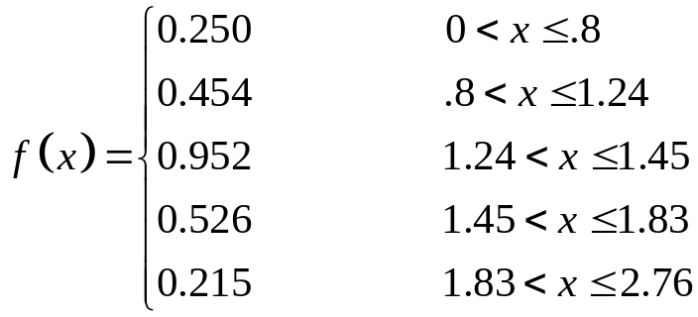
Inverse Transformation - Empirical
Consider the following continuous empircal pdf:
You might note that in the above example, each of the ranges has an equal probability (0.2).
The CDF for this function is given on the right.
JTB 2002

Slide 8
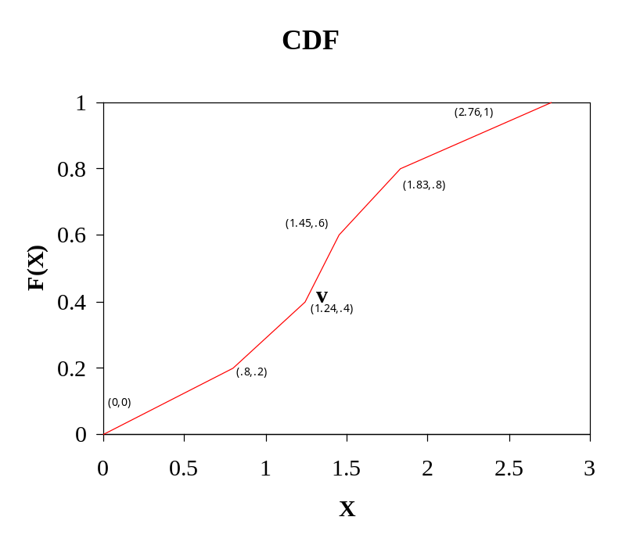
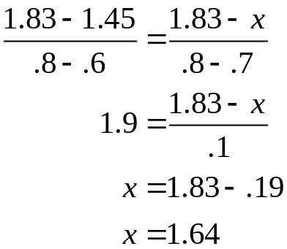
Inverse Transformation - Empirical
The inverse transformation method works well on continuous empirical functions.
For example let’s say we have selected r = 0.7. By eyeball we’d say this corresponds to X ~ 1.7
Of course, we can determine this value analytically.
r = .7 falls in the range bounded by (1.45, 0.6), (1.83, 0.8)
By linear interpolation our point will obviously be:
JTB 2002

Slide 9
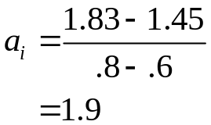
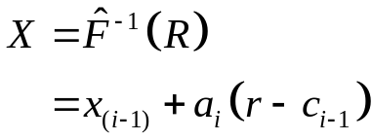
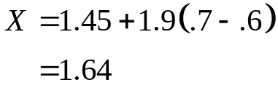
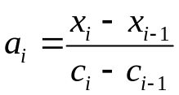
Inverse Transformation - Empirical
Formally, the formula for the inverse transformation of a continuous random distribution is:
Where x_{i} is the end of the i_{th} interval and c_{i} is the value of F(X) at x_{i.}
JTB 2002

Slide 10
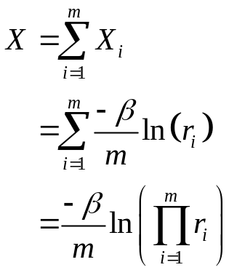
Convolution Technique - Erlang
For some intractable distributions, we can express the random variate as the sum of two or more random variates.
Recall that an Erlang distribution with parameters (m, β) can be expressed as the sum of K independent exponential random variables with mean β/m
Ex: m = 2; β = 1
Select two random numbers:
r₁ = .2; r₂ = .4
X = - 1/2ln(.2*.4) = 1.26
Thus to generate an Erlang rv, we
generate k random numbers ~U(0,1)
and use them to return X.
JTB 2002

Slide 11
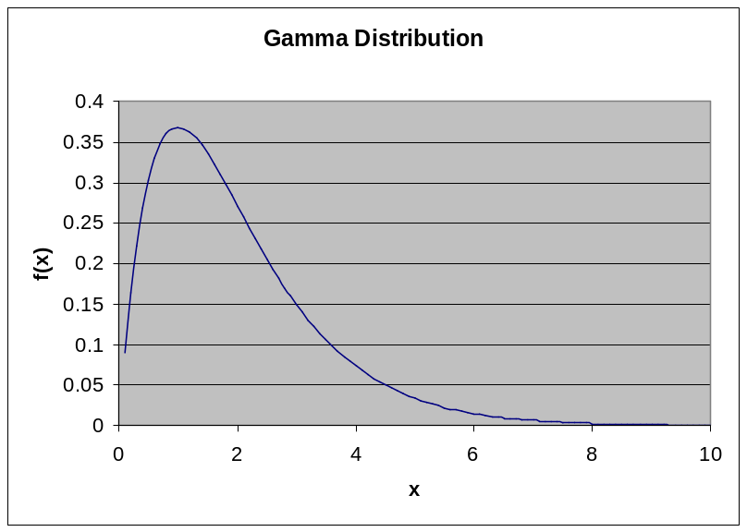
Acceptance – Rejection Technique
For other intractable distributions (like the gamma) we must use a slightly more involved process.
On the right is a gamma(.75,1) distribution.
A closed form for F(X) does not exist, so what we’ll do is add in another distribution for which we do know how to calculate the CDF and its inverse.
We pick a function t(x) that is larger than f(x) for all x. Technically we say that t(x) majorizes f(x).
JTB 2002

Slide 12
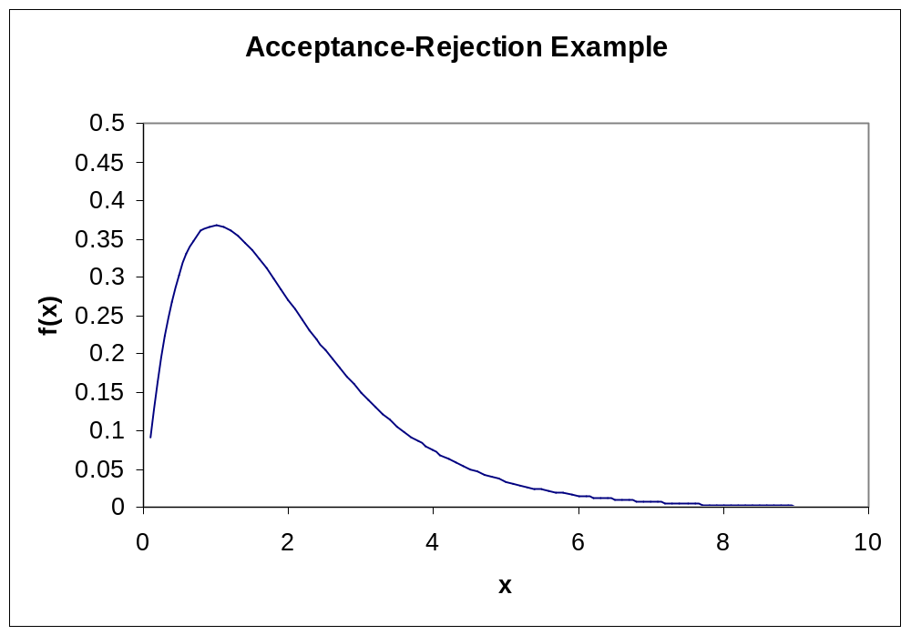
Acceptance – Rejection
t(x) = .4
JTB 2002

Slide 13
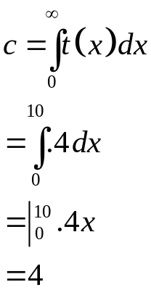
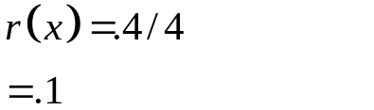
Acceptance-Rejection
In our example we selected t(x) = .4 0 <= x <= 10
Now t(x) doesn’t really fit the definition of a distribution, since its integral from 0 to 10 doesn’t add up to 1.
However let us define c: And r(x) = t(x)/c:
JTB 2002

Slide 14
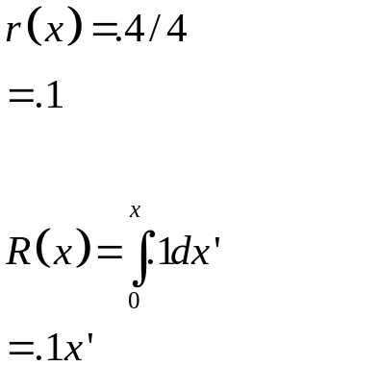
Acceptance-Rejection
Since we know the pdf of r, we can calculate the cdf:
And in this simple case, we can easily determine the inverse transformation for R: X = 10Y.
So, let’s say we pick a random number Y = .3.
This translates into an X of 3
JTB 2002

Slide 15
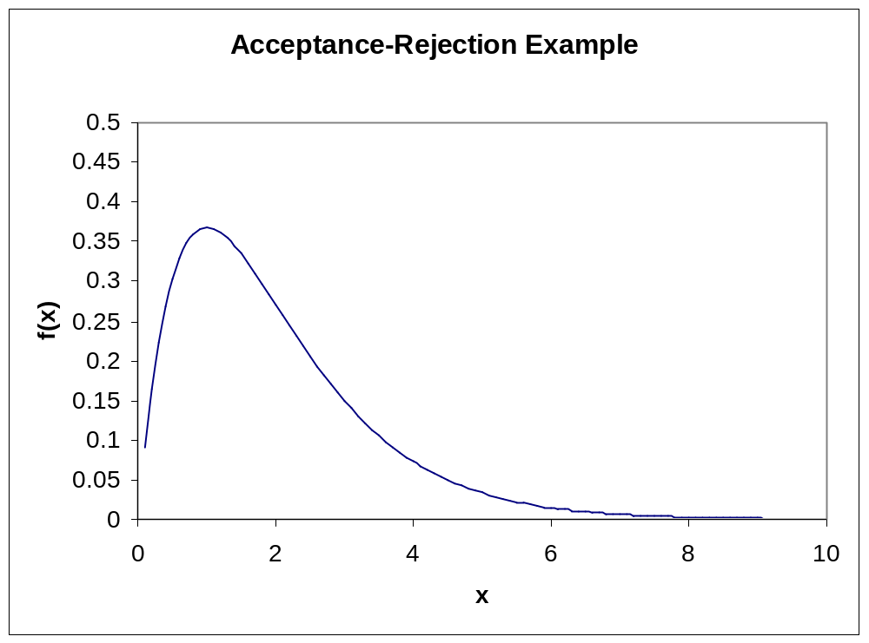
Acceptance – Rejection
t(x) = .4
If we threw darts that could land only on the line x = 3, then the probability that a dart hitting inside the distribution would be f(X=3)/t(X=3).*
*Note: I am using slightly different notation than in Law and Kelton
JTB 2002

Slide 16
Acceptance – Rejection
t(x) = .4
f(X=.3)/t(X=.3)
= .15/.4
= .375
Draw U~U(0,1).
If U is less than .375, we will accept X= 3 as coming from a gamma(2,1) distribution.
Otherwise, we will start the process over by selecting a new R and new U.
*Note: I am using slightly different notation than in Law and Kelton
JTB 2002

Slide 17
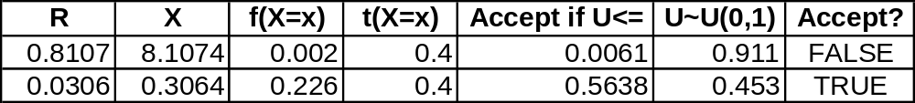
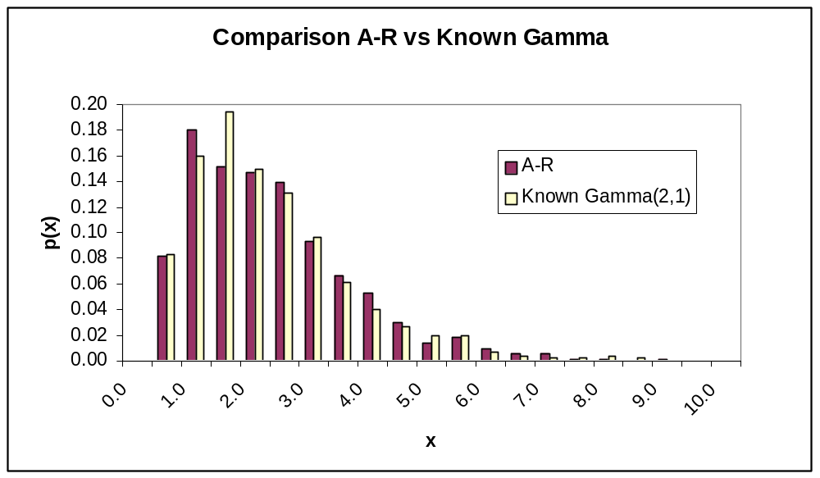
Acceptance – Rejection
For illustration, I have included the calculations for one call to the function to return a random variate for the gamma(2,1) distribution. In this example, the value .3064 would be returned.
For comparison, I’ve generated a histogram using the A-R technique and t(x) =.4 and compared it against a histogram from a known Gamma (2,1) distribution.
n = 1000 in this case. As you can see, the technique performs reasonably well.
JTB 2002

Slide 18
Acceptance – Rejection (Continued)
Now, as you might imagine, the function t(x) = .4 isn’t a particularly great choice as a majorizing function.
Note that there are some wide gaps between t(x) and f(x).
This will impact the efficiency of our generation procedure, since we’ll end up throwing out a lot of generated values before we’ll accept one.
JTB 2002

Slide 19
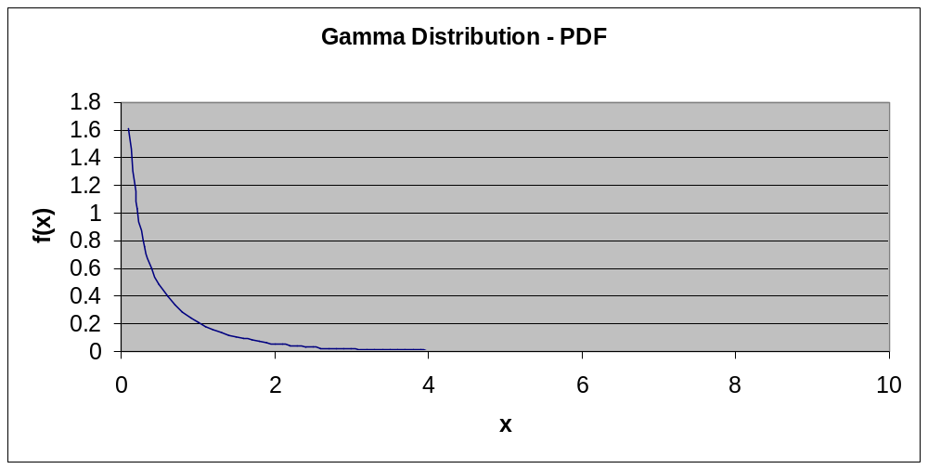
Gamma (0.5, 1) Example
JTB 2002

Slide 20
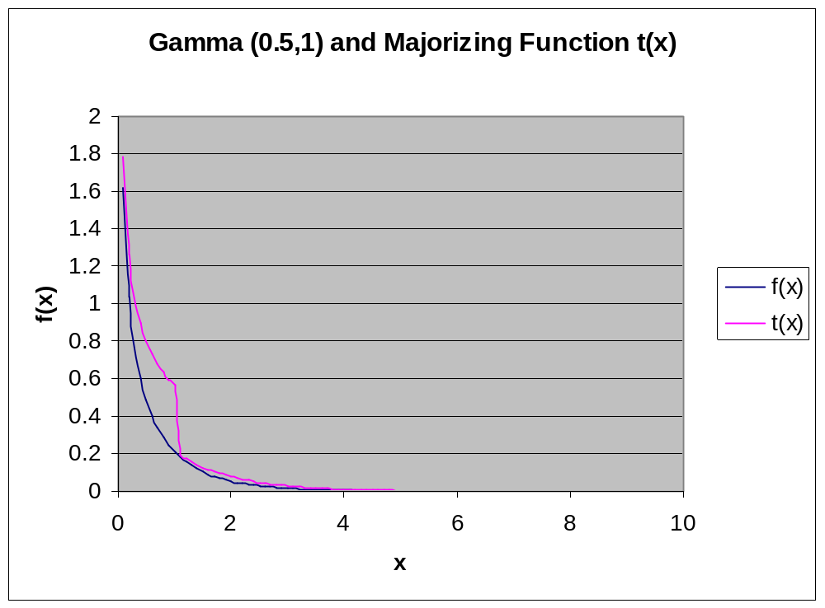
An Example with Gamma(.5,1)
JTB 2002

Slide 21
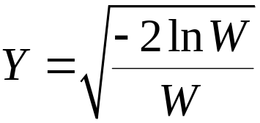
Generating Normal Variates
The following recipe (Marsaglia and Bray) generates pairs of random variates on N(0,1):
Generate U₁, U₂ as U(0,1).
Let V₁ = 2U₁ – 1
V₂ = 2U₂ – 1
W = V₁² + V₂²
If W > 1, then go back to 1 and try again.
Otherwise, let:
X₁ = YV₁ and X₂ = YV₂ are IID N(0,1) variates.
JTB 2002

Slide 22
Normal Example
U₁ = 0.8, U₂ = 0.3
V₁ = 2(.8) – 1 = .6
V₂ = 2(.3) – 1 =-.4
W = .6² + (-.4)² = 0.52
W is <= 1, we can continue.
Y = (-2ln(.52)/(.52))^{.5} = 1.586
X₁ = 1.586(.6) = .952
X₂ = 1.586(-.4) = -.634
JTB 2002

Slide 23
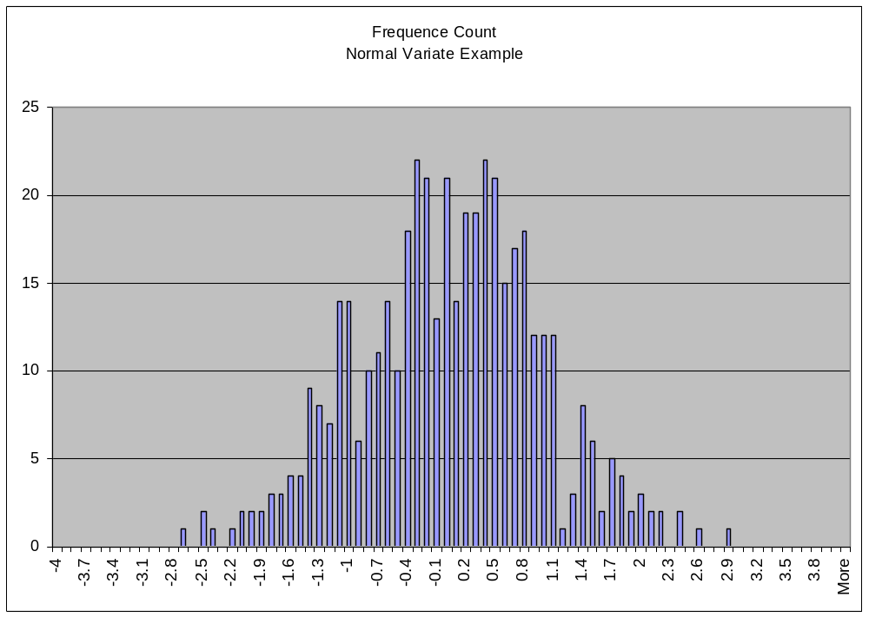
Normal Example – 300 Pairs
JTB 2002

Slide 24
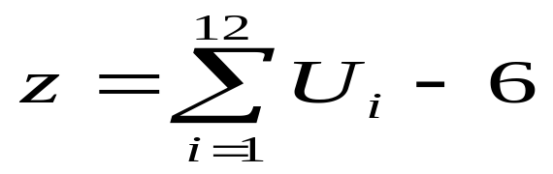
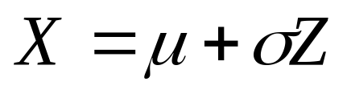
Alternative :
z → N (0 , 1)
JTB 2002

Slide 25
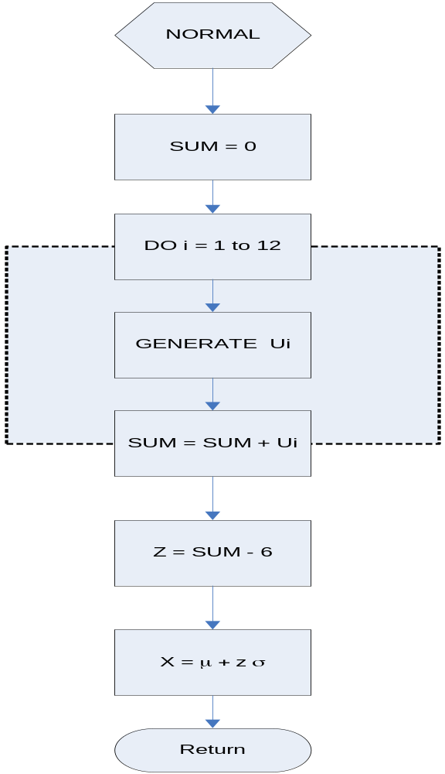
JTB 2002

Slide 26
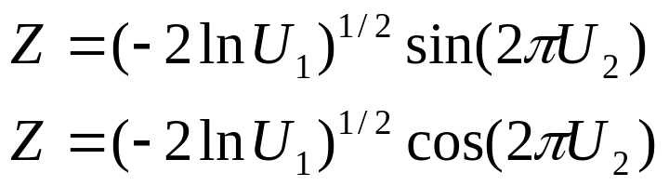
Alternative :
z → N (0 , 1)
JTB 2002

Slide 27
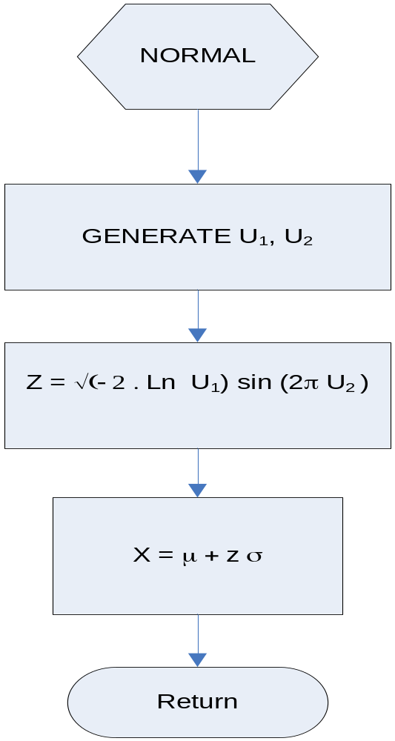
JTB 2002

Slide 28
Normal Example – 300 Pairs
JTB 2002

Slide 29

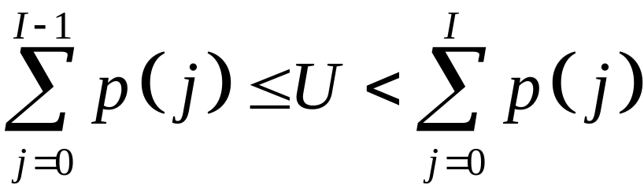
Generating Other Discrete Variates
Discrete Uniform
  Generate U~U(0,1)
  Return X =
Arbitrary Discrete
  Generate U~U(0,1)
  Return X such that
JTB 2002

Slide 30
Generating Other Discrete Variates
Bernoulli Trial (Bern(p))
  Generate U~U(0,1)
  If U <= p, return 1, otherwise return 0.
Binomial (bin(t,p))
  Generate Y₁, Y₂, …Y_{t} Bernoulli(p) variates
  Return X = Y₁+Y₂ + … +Y_{t}
JTB 2002

